Slide 1
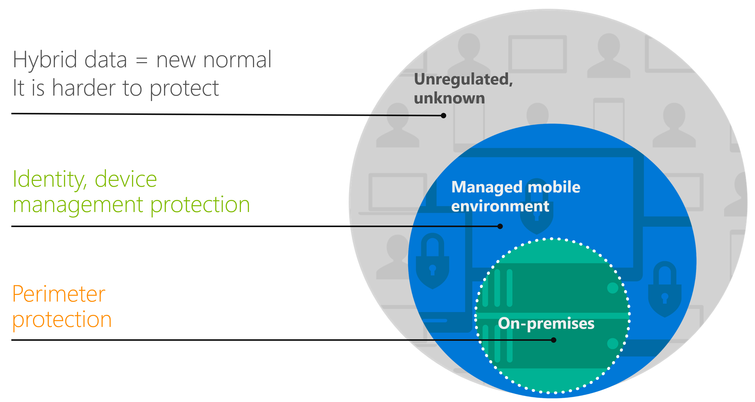
Microsoft 365 Information Protection
Module 5
SoftUni Team
Technical Trainers
Software University
http://softuni.bg

Slide 2
Questions
sli.do # SaaS-Security

Slide 3
Table of Contents
Information protection technologies
Azure Information Protection
Data Loss Prevention
Demonstration

Slide 4
Information protection technologies

Slide 5
Encryption at rest vs encryption in transit
Kinds of content | Encryption technologies
Files on a device. This can include email messages saved in a folder, Office documents saved on a computer, tablet, or phone, or data saved to the Microsoft cloud | BitLocker in Microsoft datacenters. BitLocker can also be used on client machines, such as Windows computers and tablets Distributed Key Manager (DKM) in Microsoft datacenters Customer Key for Microsoft 365
Files in transit between users. This can include Office documents or SharePoint list items shared between users | TLS for files in transit
Email in transit between recipients. This includes email hosted by Exchange Online | Office 365 Message Encryption with Azure Rights Management, S/MIME, and TLS for email in transit

Slide 6
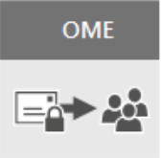
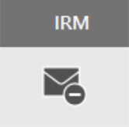
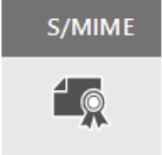
OME, IRM and S/MIME
Built on Azure RMS (Rights Management Services)
Use Azure RMS templates to:
Only encrypt
Do not forward
Company protect
No additional setup required
Can configure Exchange Online IRM to use on-premises AD RMS
Not very common
Well known protocol
Used for encryption and signing
Requires certificates and publishing infrastructure
You must have the public keys for each recipient

Slide 7
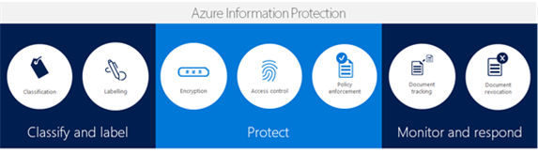
Azure Information Protection
Classify your data based on sensitivity
No matter where it is stored - protection follows the document
Deployment flexibility and ease of use

Slide 8
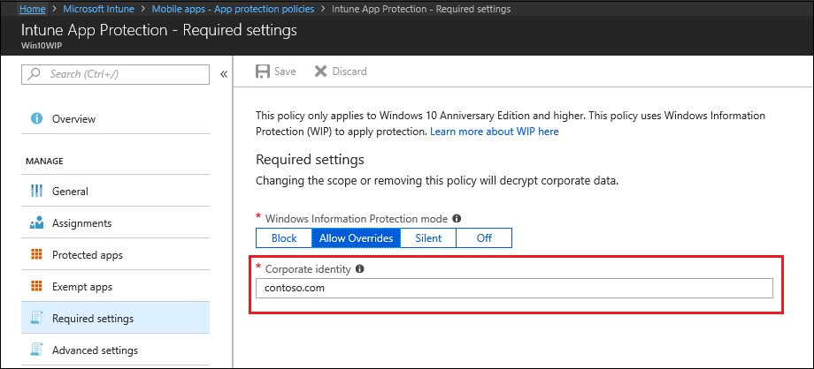
Windows Information Protection (WIP)
Windows Information Protection helps protect your corporate data by separating the business and the personal data and applying restriction policies
WIP is the mobile application management (MAM) mechanism on Windows 10
The WIP feature is built in Windows 10 (version 1607 and later)

Slide 9
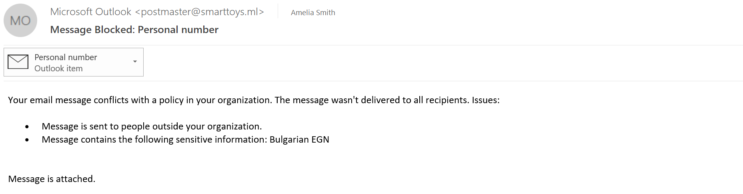
Data Loss Prevention
Data Loss Prevention (DLP) is a security feature that protects sensitive data in email, SharePoint content, and Office files from being accidentally or intentionally shared with unauthorized users

Slide 10
Cloud app security
Cloud App Security provides a dashboard to discover, investigate and control what cloud applications are being used in your organization
Discovers and controls the use of Shadow IT
Detects and fights against cyberthreats across all your Microsoft and third-party cloud services

Slide 11
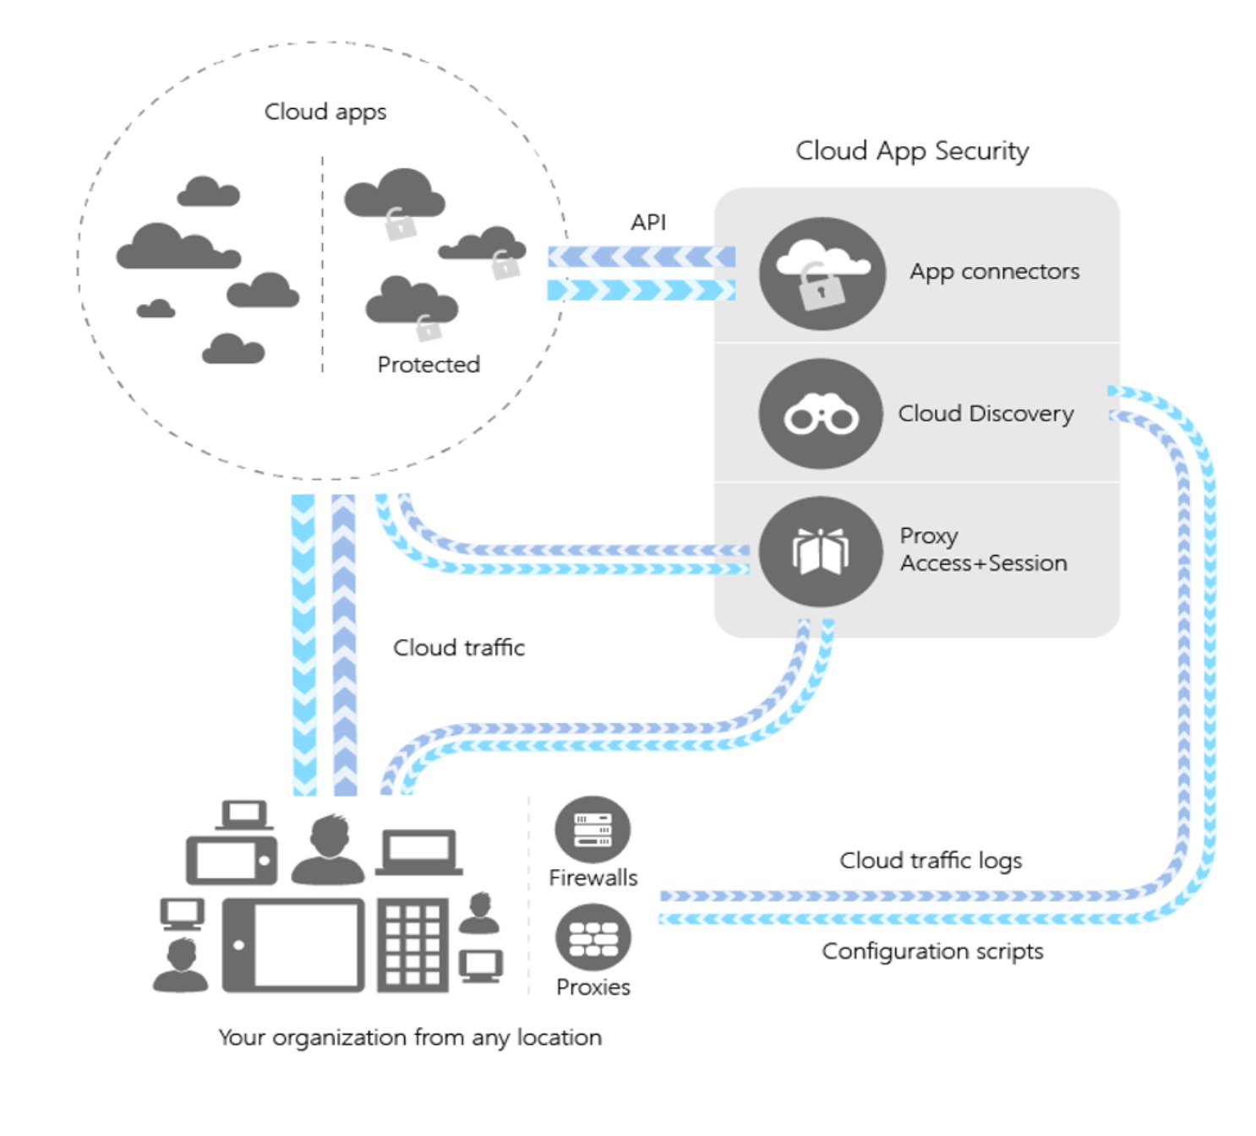
Cloud app security (2)
Microsoft Cloud App Security helps you do three things:
Gain visibility into what cloud applications are being used in your organization today
Implement data control over those applications
Leverage ongoing behavioral analytics as a part of the threat protection model

Slide 12
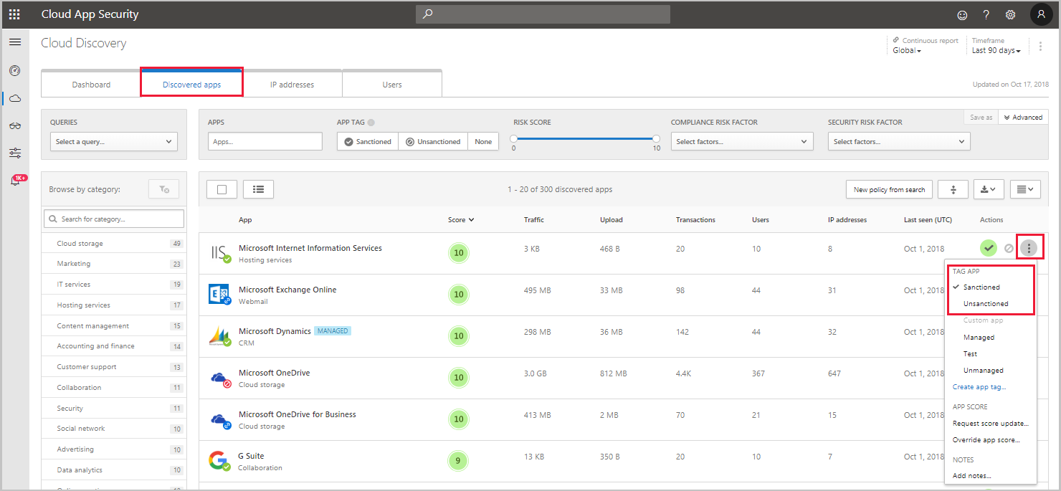
Sanctioning and unsanctioning an app

Slide 13
Conditional Access App Control protection
Azure AD Conditional Access and Cloud App Security can work together to provide session control for cloud apps
Conditional access enables administrators to route users to Cloud App Security, where data can be protected
Example scenarios:
Block downloads from unmanaged devices
Block access from unmanaged devices via client certificates
Monitor use of sanctioned applications
*MCASCAAC = Microsoft Cloud App Security Conditional Access App Control (☺)

Slide 14

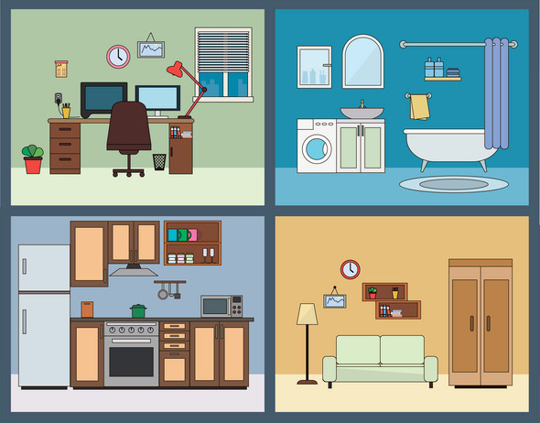

Microsoft 365
EMS – Enterprise Mobility and Security
E
M
S
Outlook, Delve
Excel, Yammer
Stream, Planner
Flow, Teams
Forms, OneNote
PowerPoint, SharePoint
StaffHub, Stream
Sway, OneDrive
Etc…
Office 365
Windows 10

Slide 15












Enterprise Mobility and Security (EMS)
Extend enterprise-grade security to your cloud and SaaS apps
Microsoft Cloud App Security
Microsoft
Intune
Azure Active Directory Premium
Azure Information Protection
Protect your data, everywhere
Protect your users, devices, and apps
Detect threats early with visibility and threat analytics
Microsoft
Advanced Threat Analytics

Slide 16
Questions
sli.do # SaaS-Security

Slide 17
Azure Information Protection

Slide 18

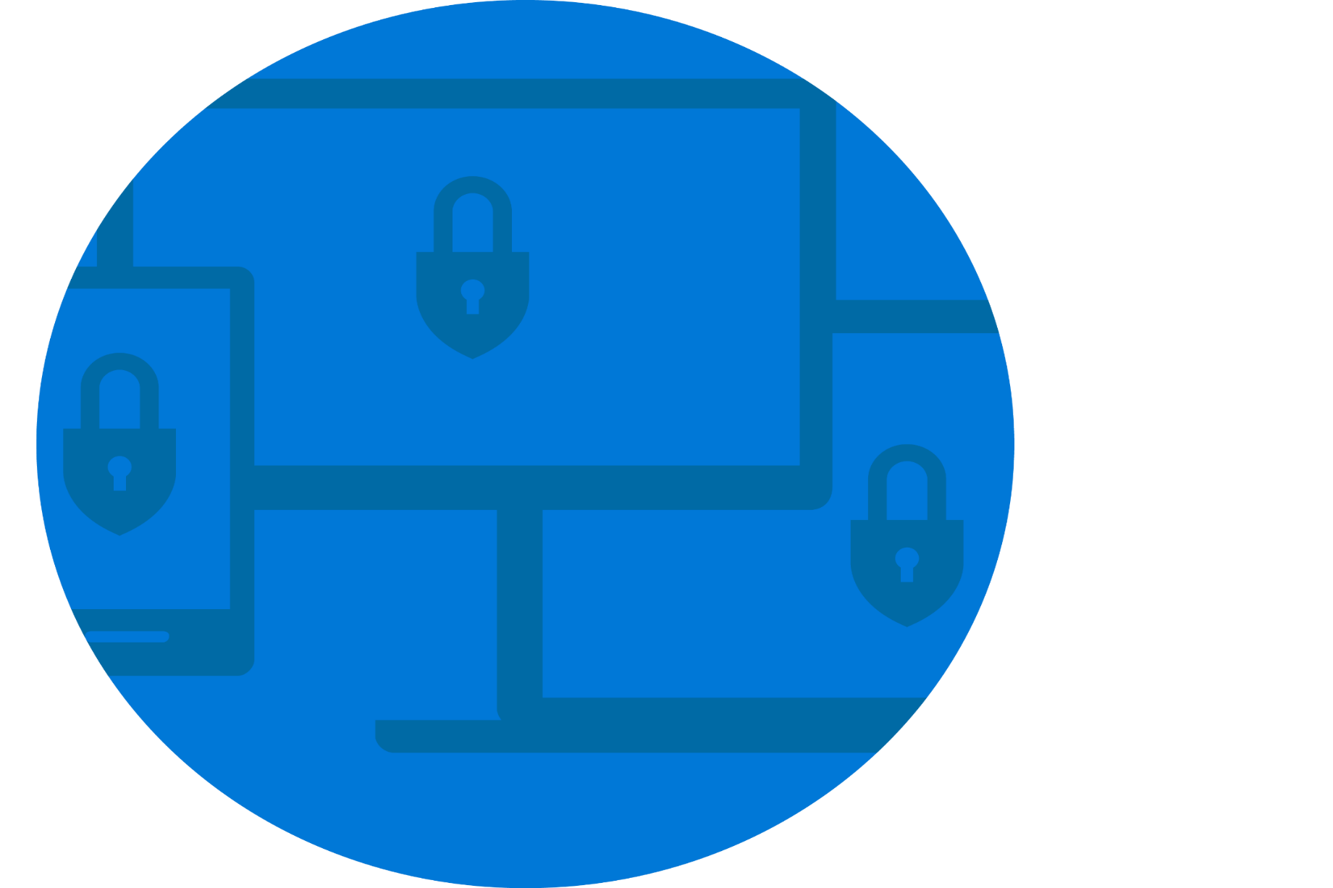

Where is your protection?
Hybrid data = new normal
It is harder to protect
Unregulated, unknown
Identity, device management protection
Managed mobile environment
Perimeter protection
On-premises

Slide 19

Azure Information Protection
Full Data Lifecycle
CLASSIFICATION
LABELING
ENCRYPTION
ACCESS CONTROL
POLICY ENFORCEMENT
DOCUMENT TRACKING
DOCUMENT REVOCATION
Classify & Label
Protect
Monitor & Respond

Slide 20
Planning Azure Information Protection deployment
Choose the right subscription and provide licenses
Prepare the tenant for AIP
Configure and deploy classification and labeling
Prepare for data protection (manage the tenant key)
Configure AIP policies, applications and services
Use and monitor your data protection solution
Administer the protection service for your tenant account
Notes:
https://docs.microsoft.com/en-us/azure/information-protection/deployment-roadmap

Slide 21
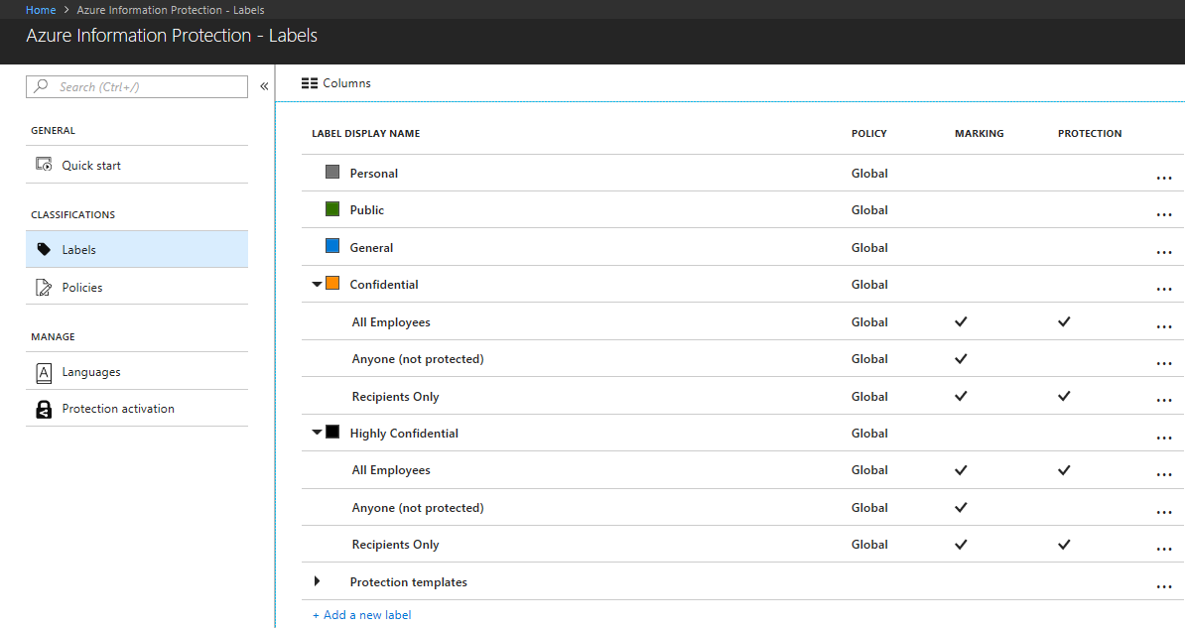
AIP labels
Contains settings on how to mark and optionally protect documents
Sub-labels add additional settings to a label
Before creating labels, you must have your classification strategy
AIP provides default labels and policies when enabled in your tenant

Slide 22
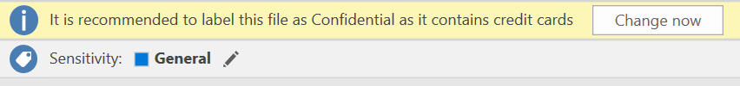
Classification and labeling
Automatic classification
Policies can be set by IT Admins for automatically applying classification and protection to data
Recommended classification
Based on the content you’re working on, you can be prompted with suggested classification
Manual reclassification
You can override a classification and optionally be required to provide a justification
User-specified classification
Users can choose to apply a sensitivity label to the email or file they are working on with a single click
HIGHLY CONFIDENTIAL
CONFIDENTIAL
PERSONAL
GENERAL
PUBLIC

Slide 23
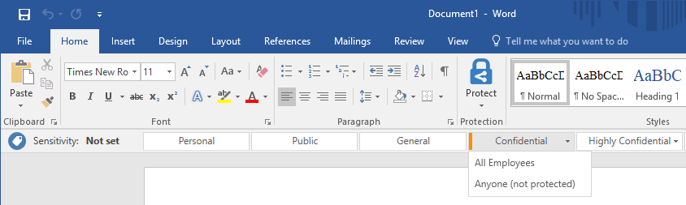
Working with AIP labels
You can see your configured labels and sub-labels when opening suported Office application on a client that has the Azure Information Protection client installed
You can use Azure Portal to create additional labels (and sub-labels) with special settings for your users

Slide 24
AIP policies
A policy is an additional set of rules that are used to group labels to be available for users or groups
All predefined labels and sub-labels in Office 365 are configured in the default policy named “Global”
You cannot scope Global policy to any specific users or groups
The following rules apply when creating new policies:
Custom labels can be added to only one policy
To add a sub-label, its parent label must be in the same policy or in the global policy
The Azure Information Protection client checks for any changes whenever a supported Office application starts

Slide 25
AIP clients
AIP provides a client-server solution that helps to protect an organization's documents and emails
Two options for AIP client download:
AIP classic client (more features, currently)
AIP unified labeling client (can also be used by MacOS, iOS, and Android)
Full comparison between the clients can be found here
Options to install the AIP client:
Manually run the executable (.exe) version
Centrally deploy the windows installer (.msi) version
Notes:
https://docs.microsoft.com/en-us/azure/information-protection/rms-client/use-client#choose-which-azure-information-protection-client-to-use

Slide 26
Automated labeling
The automatic labeling feature can assign labels to documents, files and emails without user interaction when configured conditions are met
Automatic labeling consists of:
Conditions for applying labels automatically
Automatic processing and recommendations for emails with attachments
The on-premises Azure Information Protection scanner to label local documents and files
The automatic labeling requires an AIP Premium P2 license

Slide 27
Configuring a super user
AIP “super user” ensures that authorized people and services can always read and inspect the data that Azure Rights Management protects for your organization
The Super User feature is a feature to access all protected content of your tenant
By default, the super user feature is not enabled
The Super User is configured with the PowerShell cmdlets from the AADRM module (AIPService is the new name)

Slide 28
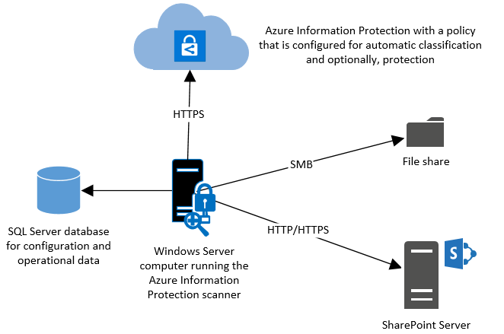
Implement bulk classification
This scanner runs as a service on Windows Server and lets you discover, classify, and protect files on the following data stores:
Local folders on the Windows Server computer that runs the scanner
UNC paths for network shares that use the Server Message Block (SMB) protocol
Document libraries and folders for SharePoint Server 2019 through SharePoint Server 2013

Slide 29
Questions
sli.do # SaaS-Security

Slide 30
Data Loss Prevention

Slide 31
What is Data Loss Prevention
Data loss prevention (DLP) is a security feature that protects sensitive data in email, SharePoint content, and Office files from being accidentally or intentionally shared with unauthorized users
With a DLP policy, you can:
Identify sensitive information across Exchange Online, SharePoint Online, OneDrive for Business, and Microsoft Teams
Prevent the accidental sharing of sensitive information
Help users learn how to stay compliant without interrupting their workflow
View DLP reports showing content that matches your organization's DLP policies

Slide 32
Sensitive information types
DLP includes many sensitive information types ready to be used in DLP policies
Defined by a pattern that can be identified by a regular expression or a function
Additional evidence (such as keywords) can be used to identify a sensitive information type
Confidence level and proximity are also used in the evaluation process
Can create your own, custom sensitive information types

Slide 33
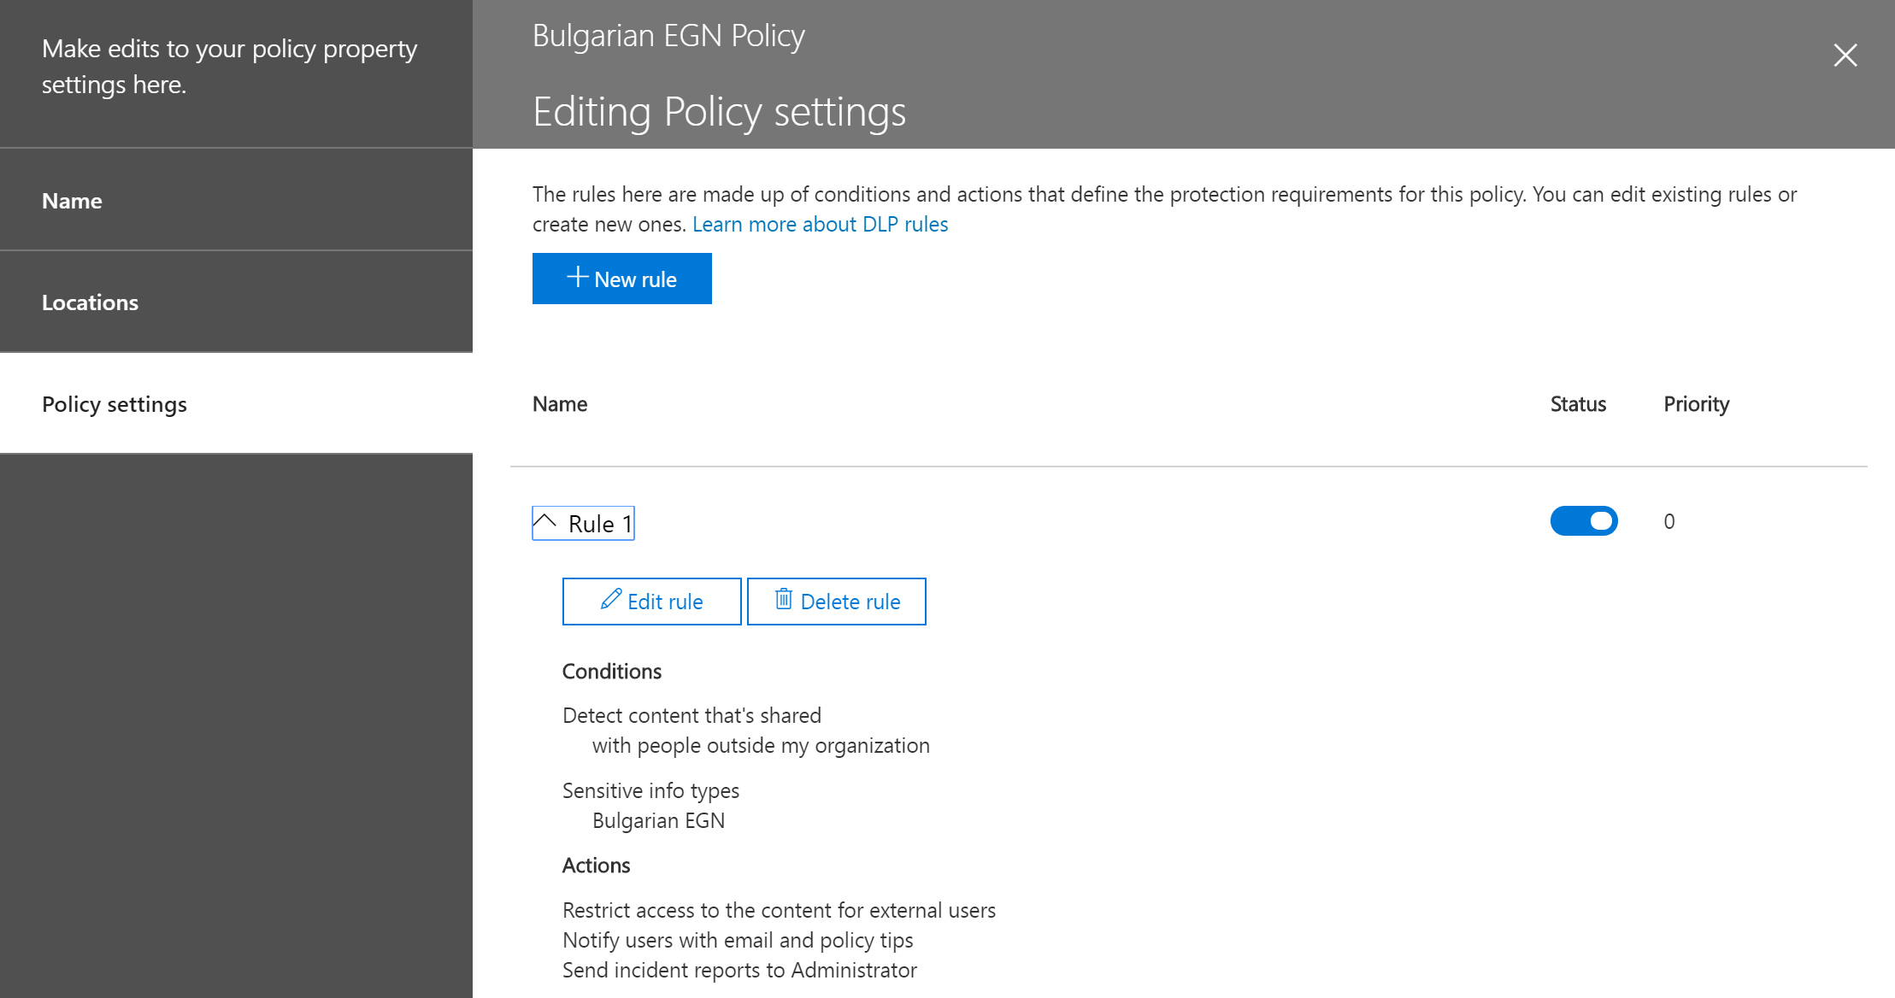
DLP policy
With a DLP policy, you can:
Identify sensitive information across Exchange Online, SharePoint Online, OneDrive for Business, and Microsoft Teams
Prevent the accidental sharing of sensitive information
Help users learn how to stay compliant without interrupting their workflow
View DLP reports showing content that matches your organization’s DLP policies

Slide 34
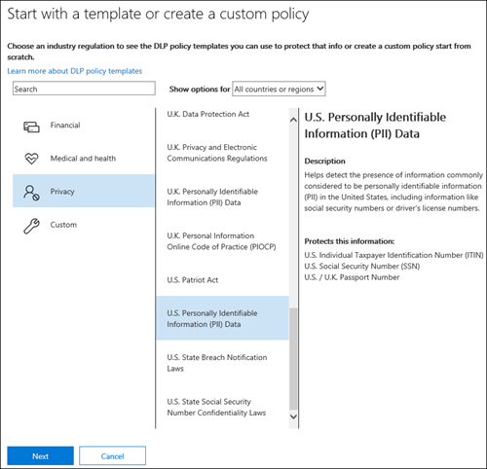
DLP policy templates
A preconfigured DLP policy template can help you detect specific types of sensitive information
The policy templates included in Office 365 already contain the most common sensitive information types necessary for you to get started

Slide 35
Questions
sli.do # SaaS-Security

Slide 36
Demonstration

Slide 37

Summary
Information protection technologies
Azure Information Protection
Data Loss Prevention
Demonstration
…
…
…

Slide 39



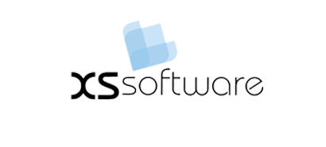


СофтУни диамантени партньори

Slide 40






СофтУни диамантени партньори

Slide 41





Trainings @ Software University (SoftUni)
Software University – High-Quality Education, Profession and Job for Software Developers
softuni.bg
Software University Foundation
http://softuni.foundation/
Software University @ Facebook
facebook.com/SoftwareUniversity
Software University Forums
forum.softuni.bg

